Slide 1
Games Development Practices
3D Modelling
CO2301 Games Development 1
Week 15

Slide 2
Today’s Lecture
Introduction
Modelling / Materials
Key-Frame Animation
Skeletons
Special Effects
Rendering

Slide 3
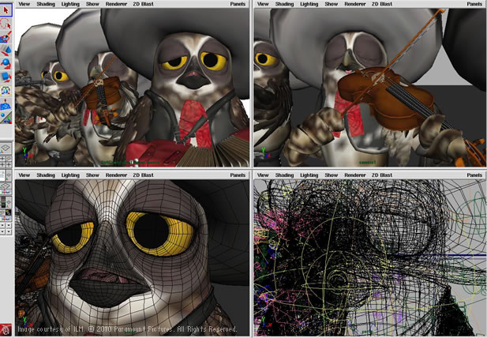
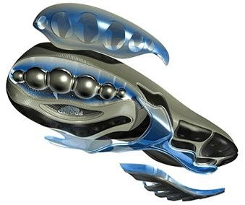
Introduction
3D modelling is simply the design / creation of 3D computer graphics
Primarily an artistic skill
  Also draws upon skills in orthographic visualisation
  Can require technical skills
3D modelling tools are frequently very complex
  Due to their huge feature-sets
The leading tools for games are 3ds Max and Maya
A very brief overview follows…

Slide 4
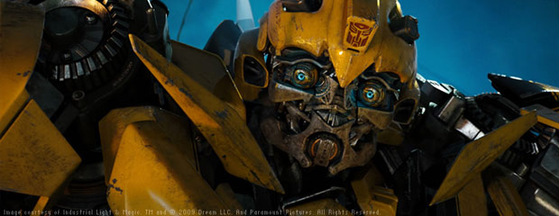
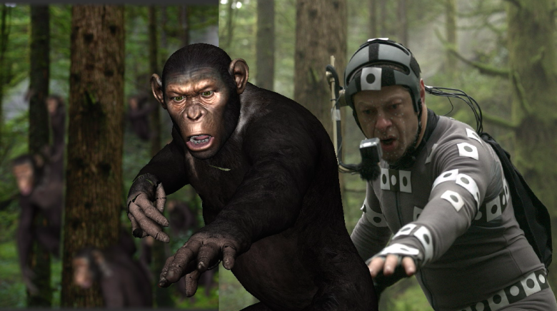
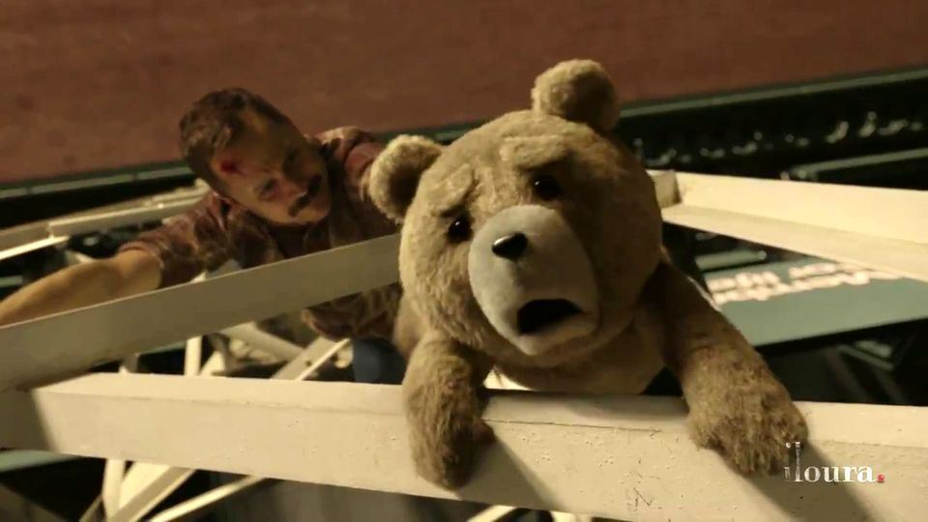
3D Modelling for Film
The film industry regularly uses 3D graphics to:
  Create fantasy scenes / effects
  Simulate difficult to shoot scenes or do stunt work
  Render additional content or backgrounds, crowds etc.
Few animations are not computer generated now
  Have been some attempts at 3D graphics to simulate real film
All the images here were created in Autodesk Maya

Slide 5
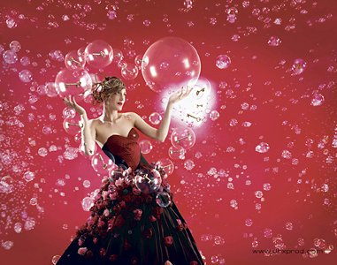

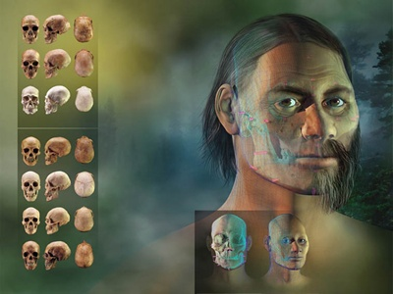
Other Media
Companies and their advertisers want ‘perfect’ images for products and models
  2D photo retouching is commonplace
Now 3D modelling tools are also often used to produce this perfection
3D graphics also used for:
  Product Design
  Architectural Visualisation
  Scientific Visualisation
DHXProd
Clinique
National Geographic Magazine

Slide 6
Computer Games
3D computer games have always required modelling tools to generate the 3D content
  A significant part of the user base for Maya and Max
Modelling tools can also be used for content creation:
  Laying out scene related data: camera paths, sound effect locations, AI networks etc.
  Helping author stats/attributes for visual elements
  Tweaking technical factors for the target platform
However, common to use a level editor and associated tools for these tasks (see 3rd year)
  The level editor interface often looks like a 3D modelling tool

Slide 7
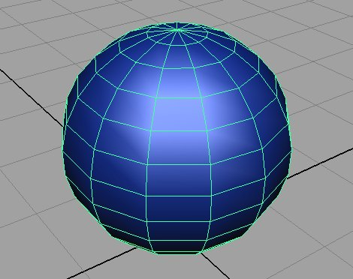
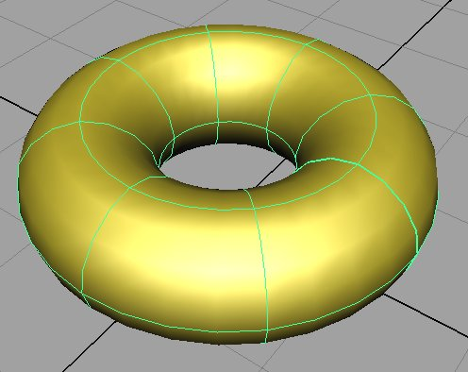
Polygonal Modelling / NURBS
A brief look at some modelling tool features…
Most basic feature is ability to create and manipulate 3D shapes
Two kinds:
  Polygonal, made of polygons
  NURBS, mathematically defined curved surfaces (Non-Uniform Rational B-Splines)
Games usually use polygonal models
  Although recent hardware advances in tessellation are increasing interest in spline-based models
Polygonal
NURBS

Slide 8
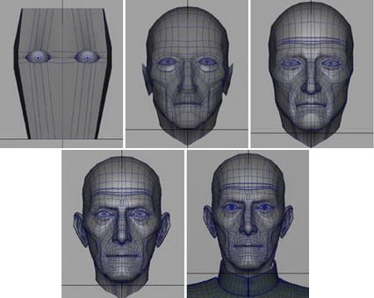
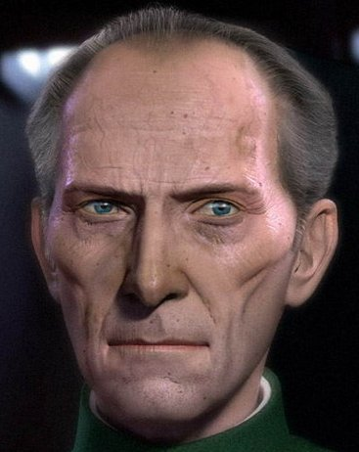
Modelling Workflow
Modelling is performed a little like sculpting
  Create basic primitives first
  Manipulate geometry directly – vertices, polygons
Also use tools such as:
  Extrusions, Booleans, Bevels/Chamfers, etc.
Modeller must also specify the materials and lighting used
  Textures (maps), surface properties, lighting propertied, etc.
Will need 2D artwork for maps
  Use Photoshop or similar

Slide 9
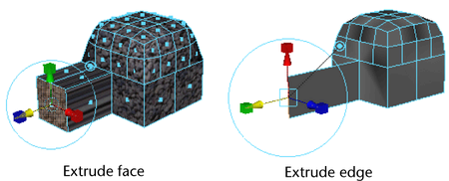
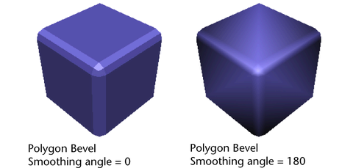
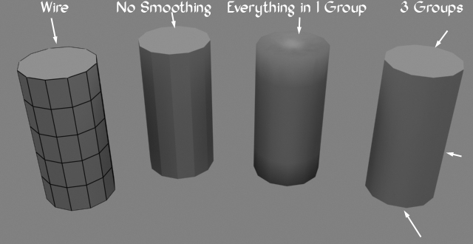
Polygon Editing
Vertices / polygons / faces can be manipulated:
  Individually
  Selected in groups
  Using soft-selections – objects near the centre of the selection affected the most
The artist is also responsible for creating normals, which defines the smoothness and edges in a surface
  Faces are collected into smoothing groups, the edges of these groups are the sharp edges of the model

Slide 10
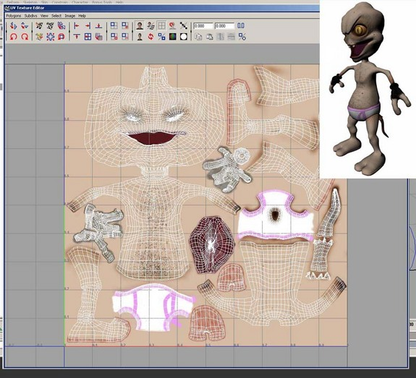
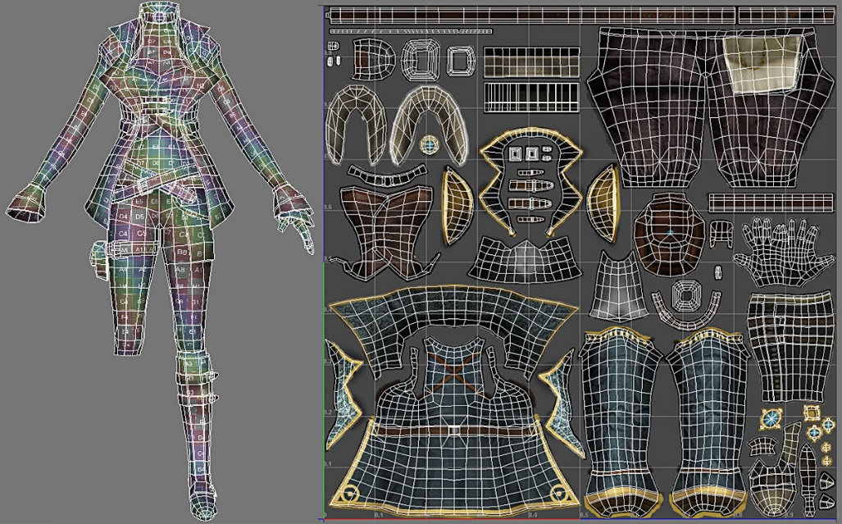
UV Mapping
Vertices in the model must be given UV coordinates if they are to have textures applied.
Modelling tools can automatically unwrap geometry onto a 2D texture rectangle
Artist manipulates the exact layout of the vertices on the texture
And draws the texture to fit in the parts

Slide 11
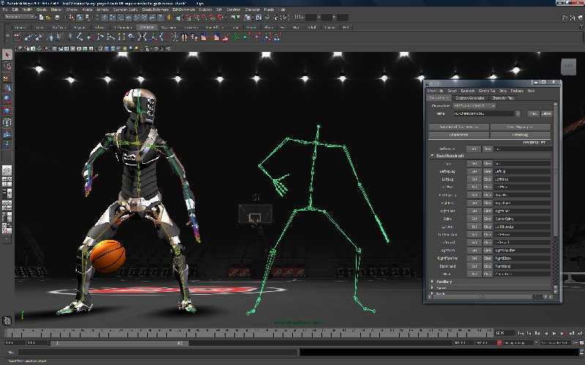
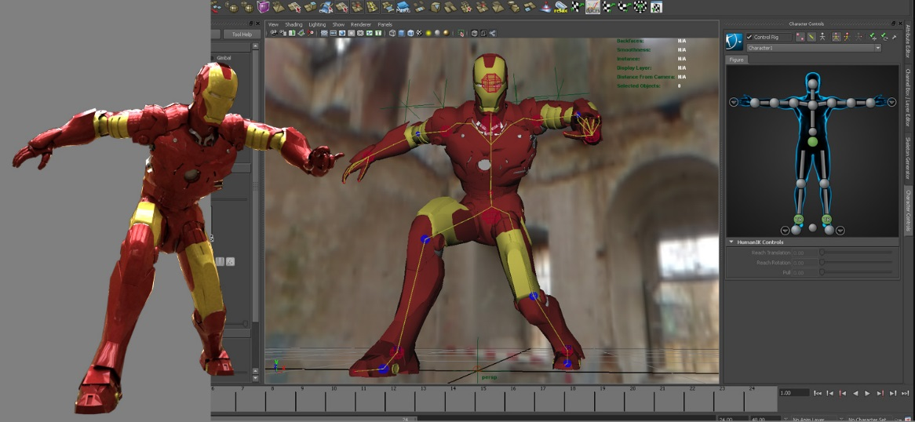
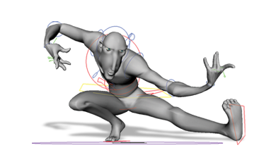
Character Rigging
Rigging is the task of putting a skeleton in an animated model (usually a character or animal)
  The exact way the bones affect the mesh is specified
  Joint limits are also set up
Rigging is an advanced task for the more skilled artist

Slide 12
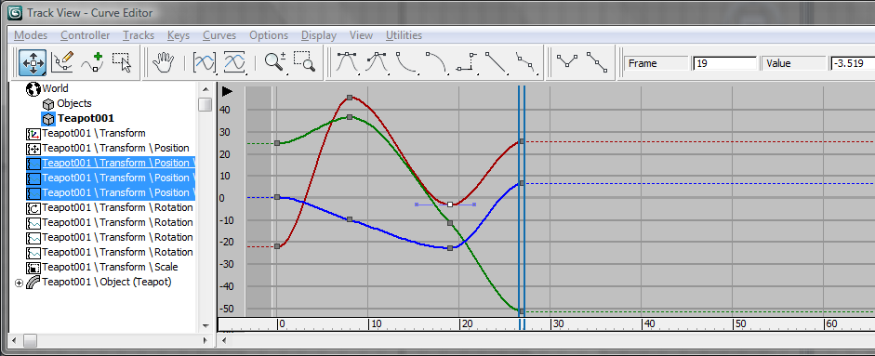
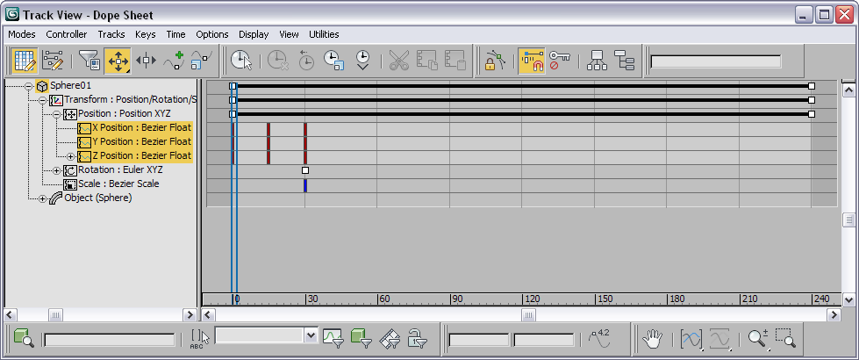
Animation
Animation is achieved by creating key frames for each object on a timeline
  Variously called a track view, curve view or dope sheet
Key frames are added when any aspect of the object changes in some way
  Position, rotation, scale
  Geometry, texture, UVs, etc
The modelling tool will interpolate the key frames to create the inbetween frames for an animation

Slide 13
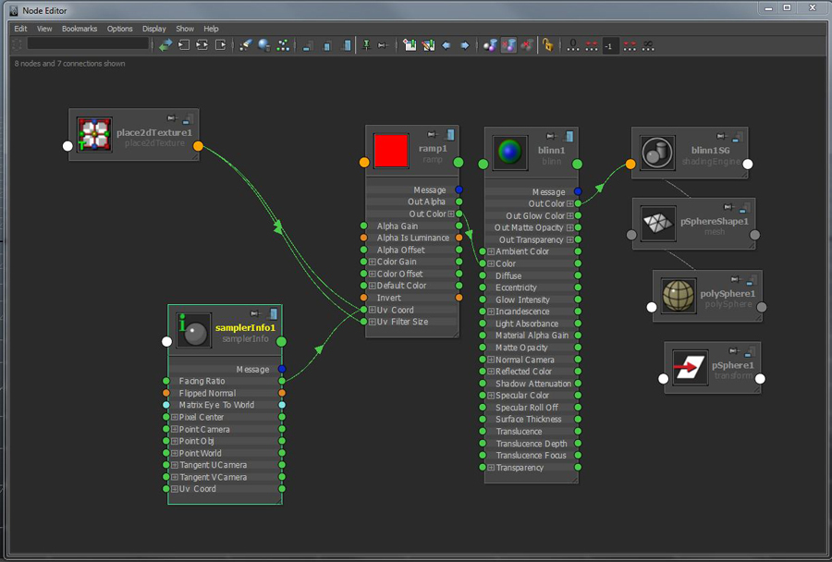
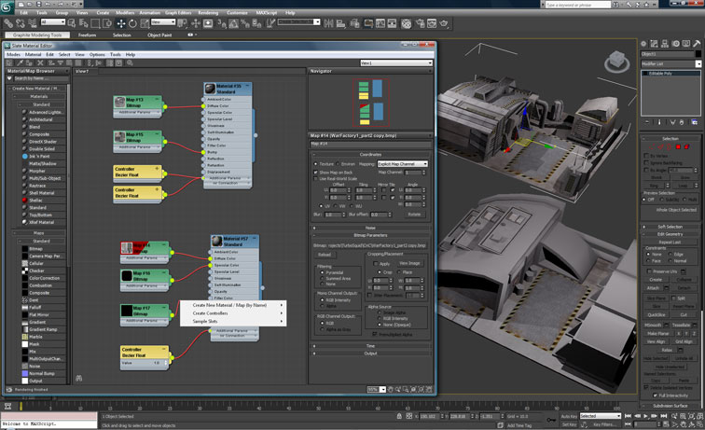
Materials / Nodes Hierachies

Slide 14
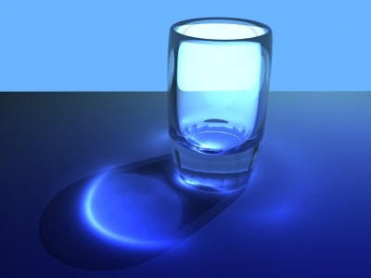
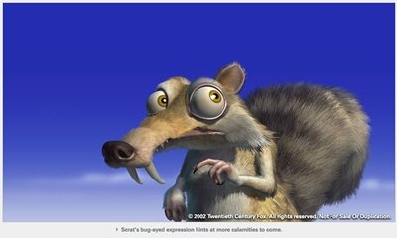
Special Effects
There are many other effects that can be modelled:
  Particle systems
  Fur, hair, grass etc
  Cloth simulations
  Very many lighting effects, radiosity, volumetric etc.
  Reflection and refraction, caustics
  Rendering fluids and gasses
  Physics: solid, liquid and gaseous
  And much more..
Caustics
Fur Effects
Ice Age Series
Twentieth Century Fox

Slide 15
Scripting
Scripting within modelling tools particularly important for games developers
All features of the application and all the scene content are exposed through a scripting language and SDK
  E.g. Maya supports a C++ API, as well as both Python and MEL scripting support at runtime
Allows programmers to write tools directly in the modelling tool to:
  Add new modelling features
  Put specific support for their product or game, such as specific shaders or performance monitoring tools
  Write custom file importers/exporters

Slide 16
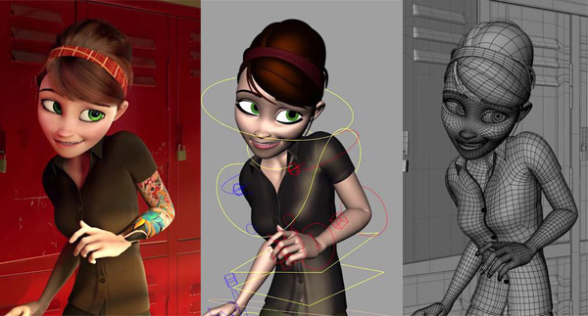
Output / Rendering
3D Modelling tools don’t render in real-time
  It can take several minutes to draw a single image, several hours to render an animation
Their focus is more on:
  A large range of features
  Best possible output quality
Many settings controlling the rendered output
  An image or a video file
But rendering is not important if you only want the 3D model, as with games development
  So we will look the export of 3D models next week

